Slide 1
STRAY ANIMAL MANAGEMENT
THE CODE CRAFTERS
- Bhagatpreet Singh Nagi
- Samyak Jain
- Aayushi Pandey
- Ashi Gupta

Slide 2
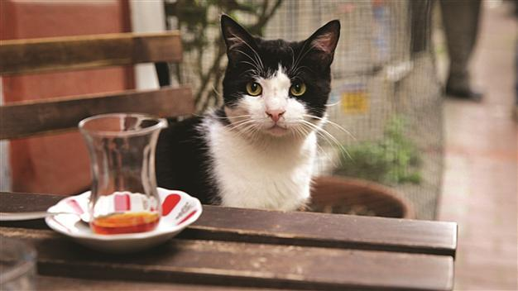
INTRODUCTION
The streets of India are full of stray animals. There are multiple NGOs working on getting the strays out of the streets, but the involvement of the citizens is next to nothing. What if there was a way to get the masses to help out the NGOs and provide the strays a healthy environment?

Slide 3
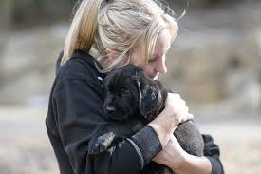
About Us
We wish to provide a solution to strays by helping them in the hour of need through the use of an online platform in which masses can update about a animal who needs our help.
This would be an interactive and social way of dealing with strays animals, resulting in reduction of starving dogs on the streets, and providing citizens with a new pet in the house.

Slide 4
Stray Animals
Stray animals are those who have never been owned and loved by the humans.
Devoid of care and affection they grow up on streets feeding and living off on the large amounts of exposed garbage that are abundant source of food.
Malnourished and weak , brought up in an unhealthy environment , they suffer from poor health and don’t receive a proper welfare.
They end up living in street because no one adopts them .They face abuse , mass killings by humans.
Often they catch dangerous diseases and end up being dead.

Slide 5
What we aim
Have you ever come across a stranded animal , a dog with broken leg or a motherless kitten crying or even a bird with a broken wing and don’t know what to do?
We through our medium “FOSTER A STRAY” aim to provide aid , shelter, food and basic amenities like veterinary treatment.
We work to create a animal friendly environment and a strategy to reduce the number of stray animals and make a better world for them.

Slide 6
How our website helps
They are countless strays in our country. We are committed to provide effective and humane solutions to these animals by our unconditional love and care.
We have created a platform that brings all animal lovers, veterinary, NGOs together to offer help.
Any person can post or update the us about the animal in distress and our team will provide an effective solution.
People can register themselves as a volunteer and create a community to spread awareness.

Slide 7
MESSENGERS OF HELP: 1. This website offers a platform which ties you DIRECTLY with the NGOs for dogs. 2. All you have to do is upload a picture and describe the animal in need. 3. The nearest NGOs will be notified and based on the urgency; aid will be provided.

Slide 8
PET THE PUPPER:
Through this website you can not only rescue the stray but also adopt one!
Whenever the mother dog gives birth to the pups, you can upload a profile for the little ones’ adoption.
You can contact directly with people willing to pet the pups.
Just put in a easy description about the puppies and give them a new life.

Slide 9
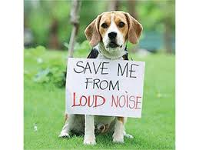
Donate for the Deprived
We are here to acknowledge the affection you show for them!
The funds raised by your help will go straight to the animals who are injured or need assistance.
These animals are bound to suffer alone be it in the chilly winters or dangerously hot summers.

Slide 10
How you can help
People willing to adopt these strays can adopt them through our platform. This will help to provide them a foster home.
Report animal abuse and take immediate actions.
Find blood donor for animals
Find lactating mother for unfortunate babies
.

Slide 11
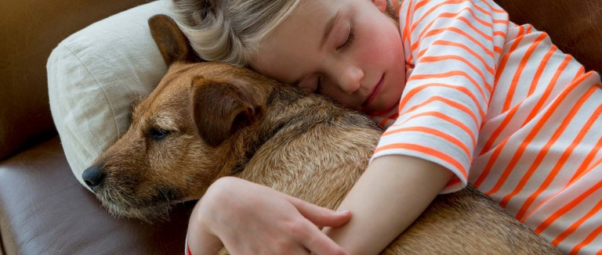
"Until one has loved an animal, a part of one's soul remains unawaken."
― Anatole France

Slide 12
Know it all
What do we know about the Indian breeds of dogs and cats? All the curious pet lovers will now know everything they seek!

Slide 13
Thank You !!

